Slide 1
Introduction to Data Mining (Cluster Analysis)
BY
Adnan Amin
Lecturer CS, IMSciences
adnan.amin@imsciences.edu.pk

Slide 2
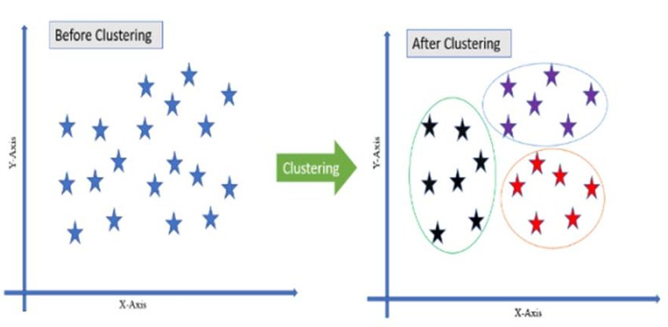
Cluster Analysis?
Cluster
A collection of data objects
Similar to one another within the same cluster
Dissimilar to the objects in other clusters
Cluster Analysis
Finding similarities between data according to the characteristics found in the data and grouping similar data objects into clusters
Clustering is unsupervised classification
no predefined classes (i.e., learning by observations vs. learning by examples: supervised)

Slide 3
Application of Clustering Analysis
Outlier detection
Outliers are often viewed as those “far away” from any cluster
Climate:
understanding earth climate, find patterns of atmospheric and ocean
Economic Science:
market research
WWW and IR
document classification
cluster Weblog data to discover groups of similar access patterns
Image Processing
cluster images based on their visual content

Slide 4
Good Clustering?
A good clustering method will produce high quality clusters with
high intra-class similarity: cohesive within clusters
low inter-class similarity: distinctive between clusters
The quality of a clustering method depends on
the similarity measure used by the method
its implementation, and
Its ability to discover some or all of the hidden patterns
Quality of clustering:
There is usually a separate “quality” function that measures the “goodness” of a cluster.
It is hard to define “similar enough” or “good enough”
The answer is typically highly subjective

Slide 5
Requirements of Clustering in Data Mining
Scalability:
Clustering all the data instead of only on samples
Ability to deal with different types of attributes:
Numerical, binary, categorical, ordinal, linked, and mixture of these
Discovery:
Discovery of clusters with arbitrary shape
Minimal requirements for domain knowledge to determine input parameters
Able to deal with noise and outliers
Insensitive to order of input records
High dimensionality
Incorporation of user-specified constraints
Interpretability and usability

Slide 6
Example of Clustering: Outliers
Outliers are objects that do not belong to any cluster or form clusters of very small cardinality
In some applications we are interested in discovering outliers, not clusters (outlier analysis)
cluster
outliers

Slide 7
Considerations for Cluster Analysis
Partitioning criteria
Single level vs. hierarchical partitioning (often, multi-level hierarchical partitioning is desirable)
Separation of clusters
Exclusive (e.g., one customer belongs to only one region) vs. non-exclusive (e.g., one document may belong to more than one class)
Similarity measure
Distance-based (e.g., Euclidian, road network, vector) vs. connectivity-based (e.g., density or contiguity)
Clustering space
Full space (often when low dimensional) vs. subspaces (often in high-dimensional clustering)

Slide 8
Major Clustering Approaches
Partitioning algorithms:
Construct random partitions and then iteratively refine them by some criterion. E.g., K-means, K-medoids
Hierarchical algorithms:
Create a hierarchical decomposition of the set of data (or objects) using some criterion. E.g., Hierarchical clustering
Density-based:
based on connectivity and density functions. E.g., DBSCAN
Grid-based:
based on a multiple-level granularity structure. E.g., WaveCluster
Model-based:
A model is hypothesized for each of the clusters and the idea is to find the best fit of that model to each other. E.g., Expectation–maximization (EM), Self Organizing Map (SOM)

Slide 9
Measuring Similarity in Clustering
Dissimilarity & Similarity metric:
The dissimilarity d(i, j) between two objects i and j is expressed in terms of a distance function, which is typically a metric:
d(i, j) ≥ 0 (non-negativity)
d(i, i) = 0 (isolation)
d(i, j) = d(j, i) (symmetry)
d(i, j) ≤ d(i, h)+d(h, j) (triangular inequality)
Similarity and Dissimilarity Between Objects:
Distance metrics are normally used to measure the similarity or dissimilarity between two data objects.
Distance metrics: (i) Minkowski, (ii) Manhattan (or city block) , (iii) Euclidean distance

Slide 10
Similarity and Dissimilarity Between Objects
Minkowski:
where i = (x_{i1}, x_{i2}, …, x_{in}) and j = (x_{j1}, x_{j2}, …, x_{jn})
are two n-dimensional data objects, and p is a positive integer
Manhattan (or city block): If p = 1
Euclidean distance: If p = 2
Also one can use weighted distance:

Slide 11
Binary Variables
A binary variable has two states: 0 absent, 1 present
A contingency table for binary data
Simple matching coefficient distance (invariant, if the binary variable is symmetric):
Jaccard coefficient distance (noninvariant if the binary variable is asymmetric):
object j
object i

Slide 12
Binary Variables
Another approach is to define the similarity of two objects and not their distance.
In that case we have the following:
Simple matching coefficient similarity:
Jaccard coefficient similarity:
Note that: s(i,j) = 1 – d(i,j)

Slide 13
Dissimilarity between Binary Variables
Example
gender is a symmetric attribute
the remaining attributes are asymmetric binary
let the values Y and P be set to 1, and the value N be set to 0

Slide 14
Dissimilarity between Binary Variables
Example (Jaccard coefficient)
all attributes are asymmetric binary
1 denotes presence or positive test
0 denotes absence or negative test
Jack: 101000
Mary: 101010
Jim: 110000
 | j1 | j0
m1 | 2 | 1
m0 | 0 | 3
Hints: https://onlinecourses.science.psu.edu/stat857/book/export/html/3

Slide 15
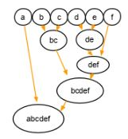
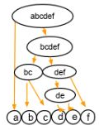

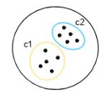
Types of Clustering
Hierarchical clustering
Agglomerative clustering (bottom-up approach)
Divisive clustering (top-down approach)
Partitioning clustering
K-means,
k-mediod,
Fuzzy C-means

Slide 16
Cluster Analysis (K-Means Algorithm)

Slide 17
Introduction to K-Means
Type of unsupervised learning (used when you have unlabeled data)
Unlabeled data:
Data without defined categories or groups
K-Means algorithm is used to find groups in the data.
The number of groups represented by K.
Data samples are grouped based on feature similarity.
Distance based
K-means is partitioning clustering algorithm
Alternative names:
Centriod-based algorithm
Distance-based algorithm

Slide 18
Real-world examples
Behavioral segmentation
Segment by purchase history, activities on web
Inventory categorization
Group sales activity
Group manufacturing metrics
Outlier detection
Separate valid and invalid groups
Detect activities types in motion sensors
Group similar/dissimilar images

Slide 19
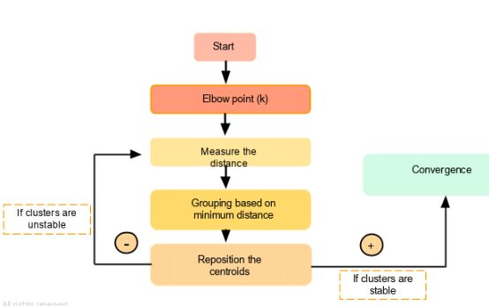
K-Means clustering flowchart
https://www.simplilearn.com/tutorials/machine-learning-tutorial/k-means-clustering-algorithm

Slide 20
K-Means Clustering
Use the k-means algorithm and Euclidean distance to cluster the following 8 examples into 3 clusters:
A1=(2,10),
A2=(2,5),
A3=(8,4),
A4=(5,8),
A5=(7,5),
A6=(6,4),
A7=(1,2),
A8=(4,9)

Slide 21
The distance matrix based on the Euclidean distance:
d(a,b) denotes the Eucledian distance between a and b. It is obtained directly from the distance matrix or calculated as follows:

Slide 22
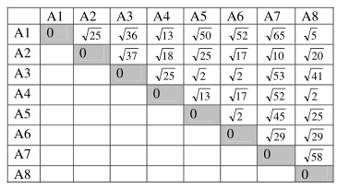
A1=(2,10), A2=(2,5), A3=(8,4), A4=(5,8), A5=(7,5), A6=(6,4), A7=(1,2), A8=(4,9)

Slide 23
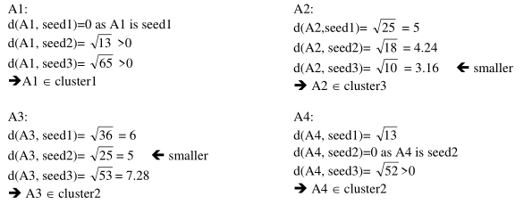
Start

Slide 24
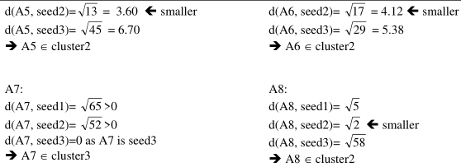
new clusters: 1: {A1}, 2: {A3, A4, A5, A6, A8}, 3: {A2, A7}

Slide 25
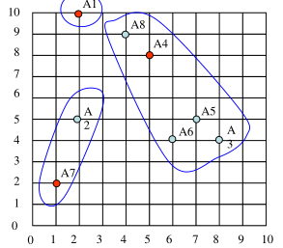
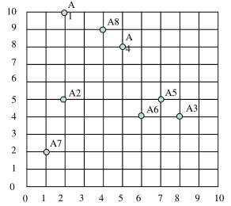
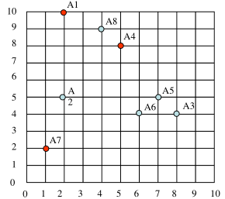
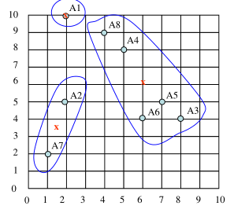
From previous new clusters:
1: {A1}, 2: {A3, A4, A5, A6, A8}, 3: {A2, A7}
centers of the new clusters
C1= (2, 10),
C2= ((8+5+7+6+4)/5, (4+8+5+4+9)/5) = (6, 6),
C3= ((2+1)/2, (5+2)/2) = (1.5, 3.5)

Slide 26
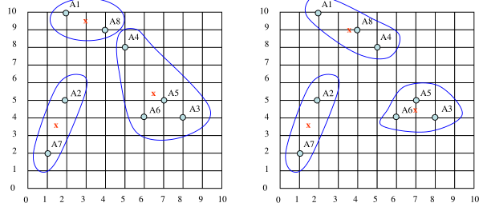
We would need two more epochs. After the 2nd epoch the results would be:
1: {A1, A8}, 2: {A3, A4, A5, A6}, 3: {A2, A7}
with centers C1=(3, 9.5), C2=(6.5, 5.25) and C3=(1.5, 3.5).
After the 3rd epoch, the results would be:
1: {A1, A4, A8}, 2: {A3, A5, A6}, 3: {A2, A7}
with centers C1=(3.66, 9), C2=(7, 4.33) and C3=(1.5, 3.5).4

Slide 27
DBScan

Slide 28
DBSCAN
Density-Based Spatial Clustering Application with Noise
locates regions of high density that are separated from one another by regions of low density.
Density, is defined as the number of points within a specified radius.
Density = number of points within a specified radius (Eps)

Slide 29
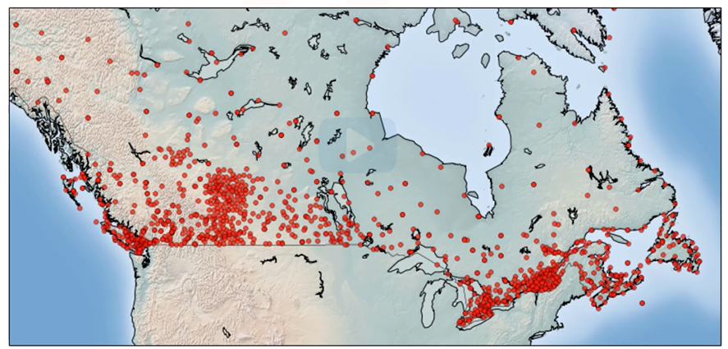
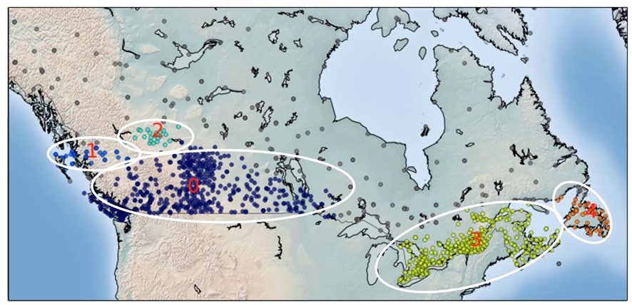
Major Application of DBSCAN
Density-Based Spatial Clustering of Applications with Noise.

Slide 30
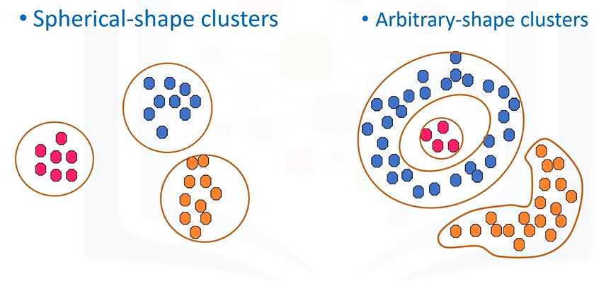
Why DBSCAN?
when applied to tasks with arbitrary shape clusters, or clusters within a cluster, the traditional techniques might be unable to achieve good results. That is, elements in the same cluster might not share enough similarity or the performance may be poor.
Most of the traditional clustering techniques, such as k-means, hierarchical and fuzzy clustering, can be used to group data without supervision.

Slide 31
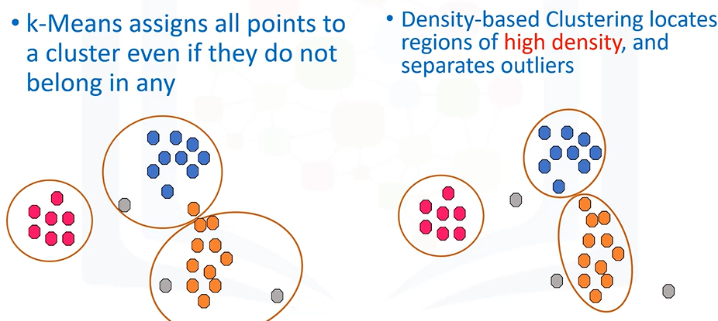
K-means vs DBSCAN

Slide 32
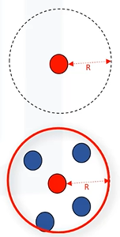
How DBSCAN works?
It works based on 2 parameters:
Radius (Radius of Neighbors) Points
R that if includes enough number of points within, we call it a dense area
Minimum (Minimum number of Neighbors) Points.
The minimum number of data points we want in a neighborhood to define a cluster.

Slide 33
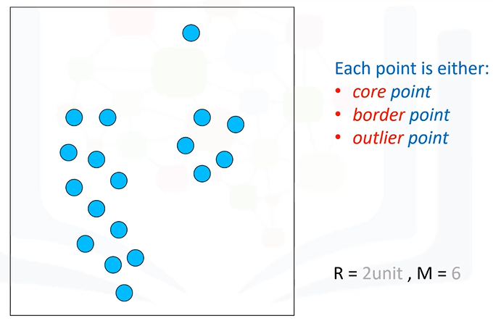
Concepts: Preliminary
A point is a core point if it has more than a specified number of points (MinPts) within Eps
These are points that are at the interior of a cluster
A border point has fewer than MinPts within Eps, but is in the neighborhood of a core point
A noise point is any point that is not a core point or a border point

Slide 34
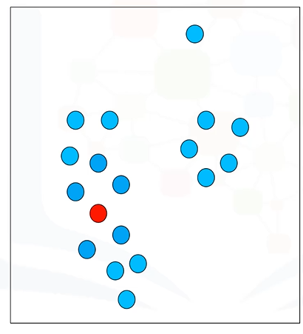
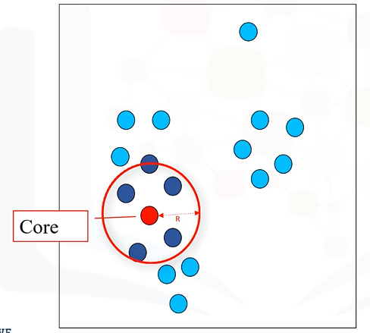
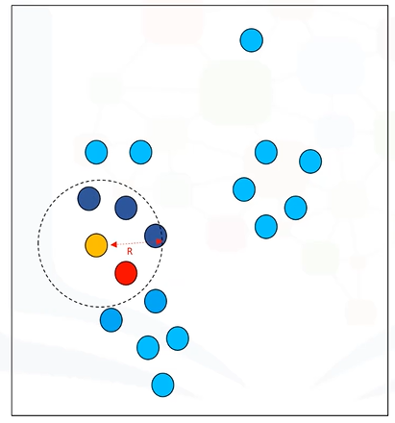

What is a core point?
Is Yellow point a core point? No.
If, within the R-neighborhood of the point, there are at least M points.
e.g., as there are 6 points in the 2-centimeter neighbor of the redpoint, we mark this point as a core point.

Slide 35
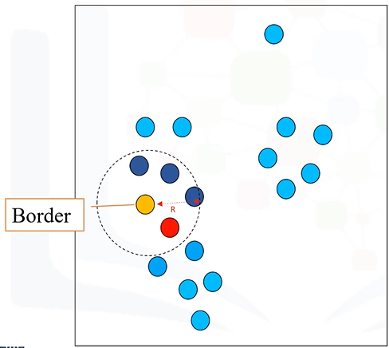
What is a Border point?
Its neighborhood contains less than M data points, or
It is reachable from some core point. Here, Reachability means it is within R-distance from a core point.
It means that even though the yellow point is within the 2-centimeter neighborhood of the redpoint, it is not by itself a core point, because it does not have at least 6 points in its neighborhood.

Slide 36
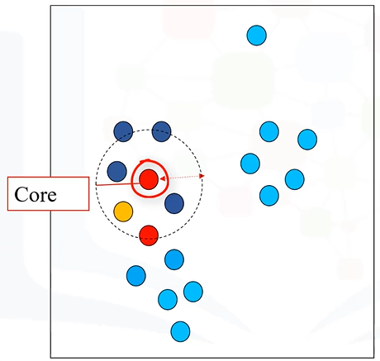
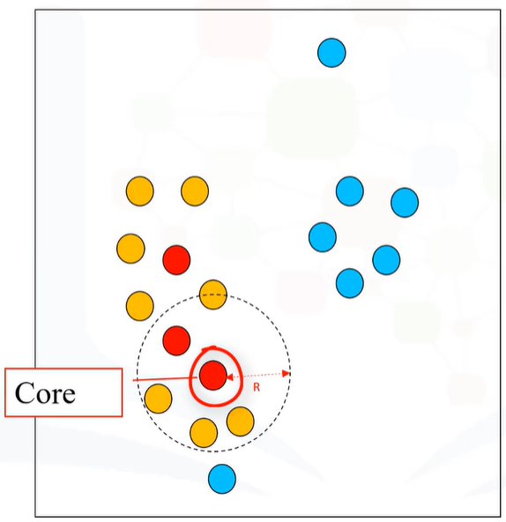
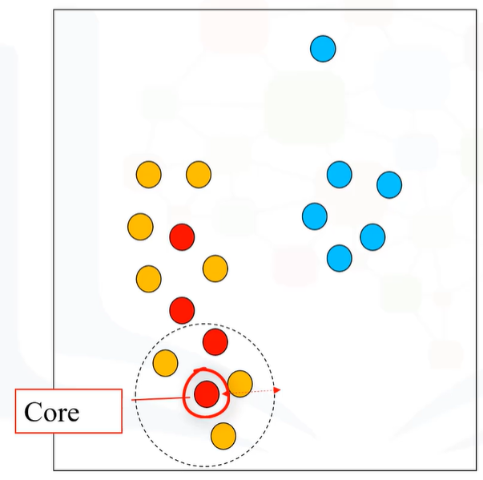
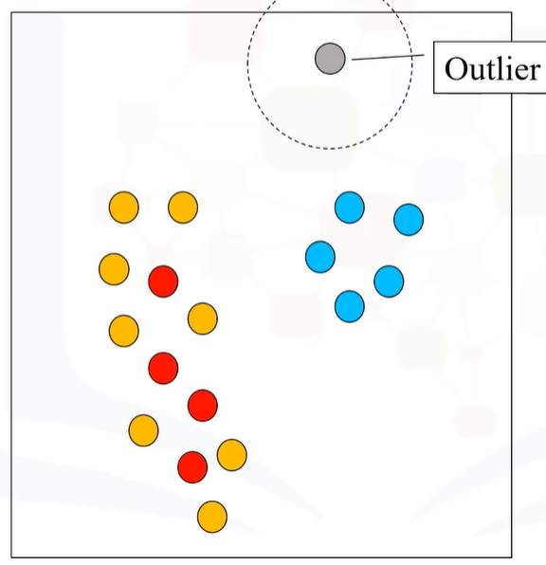
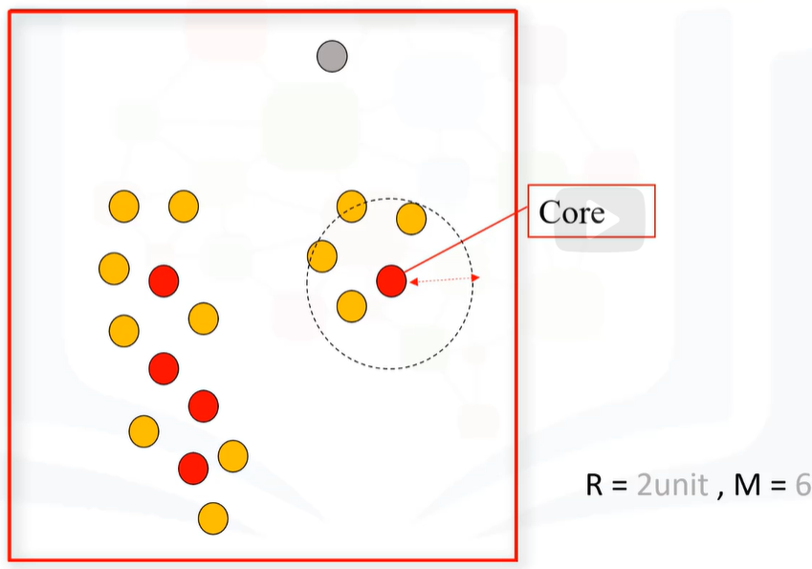
We continue and visit all the points in the dataset and label them as either Core, Border,
All red are identified as core points while yellow are border points.
Let’s take Gray point which is not a core point, nor is it a border point. So, we can label it as an outlier.

Slide 37
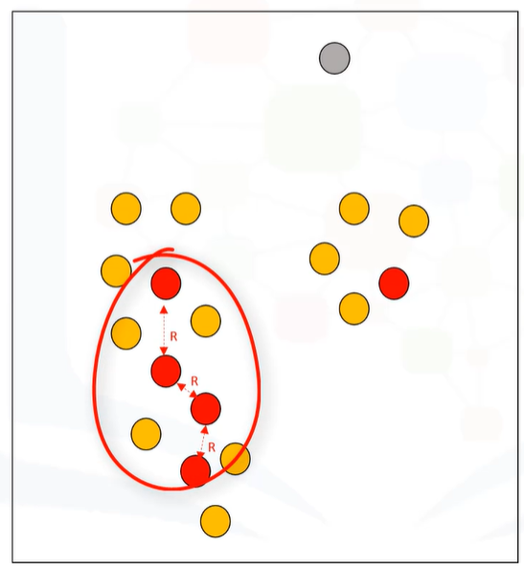
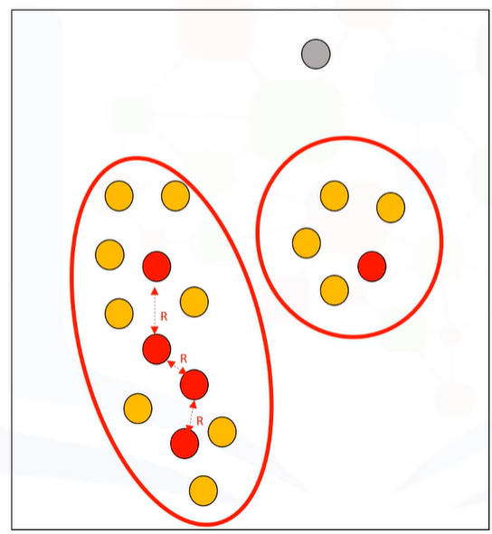
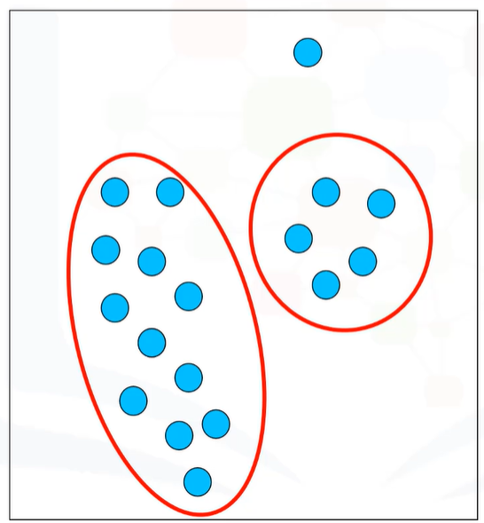
The next step is to connect core points that are neighbors and put them in the same cluster.

Slide 38
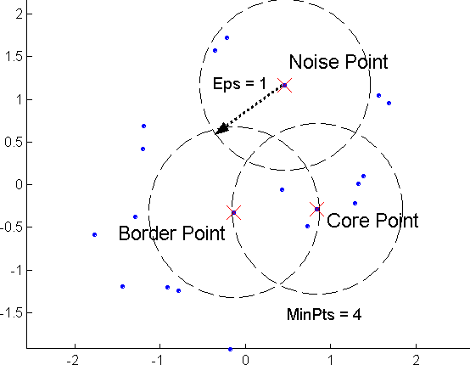
Concepts: Core, Border, Noise

Slide 39
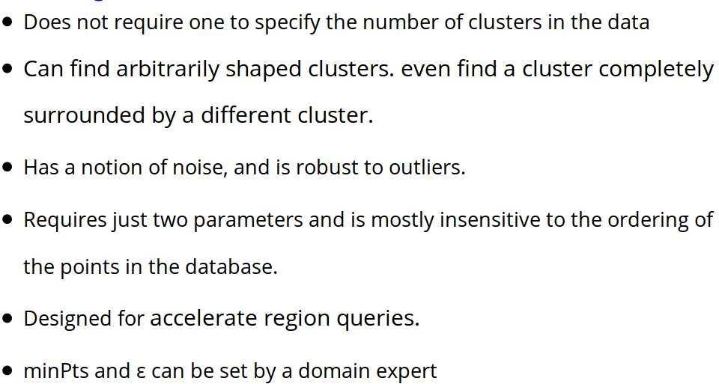
DBSCAN : Advantages

Slide 40
DBSCAN : Disadvantages
DBSCAN is not entirely deterministic: Border points that are reachable from more than one cluster can be part of either cluster, depending on the order the data is processed.
The quality of DBSCAN depends on the distance measure used in the function regionQuery. (such as Euclidean distance)
If the data and scale are not well understood, choosing a meaningful distance threshold ε can be difficult.

Slide 41
Summary of DBSCAN
Good:
can detect arbitrary shapes,
not very sensitive to noise,
supports outlier detection,
complexity is kind of okay,
beside K-means the second most used clustering algorithm.

Slide 42
Summary of DBSCAN
Bad:
does not work well in high-dimensional datasets,
parameter selection is tricky,

